Slide 1
Claims Analysis
Patrick Musi, Rajasi Deshpande, Binoy Patel, Jeffrey Batista, Viktor Zhytovoz

Slide 2
List of Apps Analysed
okCupid
Tinder
Zoosk
PlentyofFish (POF)
Match.com
AnastasiaDate
Lavalife

Slide 3
Profile Pages
A user’s personal collection of their information for other users to view
Tinder, okCupid
Pros:
Users do not have to constantly tell others their basic information
Users can quickly learn basic information about others
Cons:
Users may provide false information
Users can misinterpret personal questions answered
Users cannot make as nice of a first impression as they could in person

Slide 4
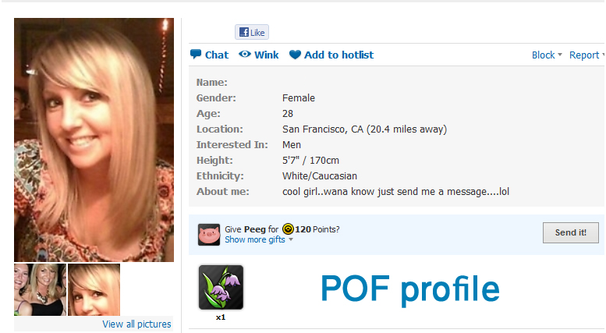
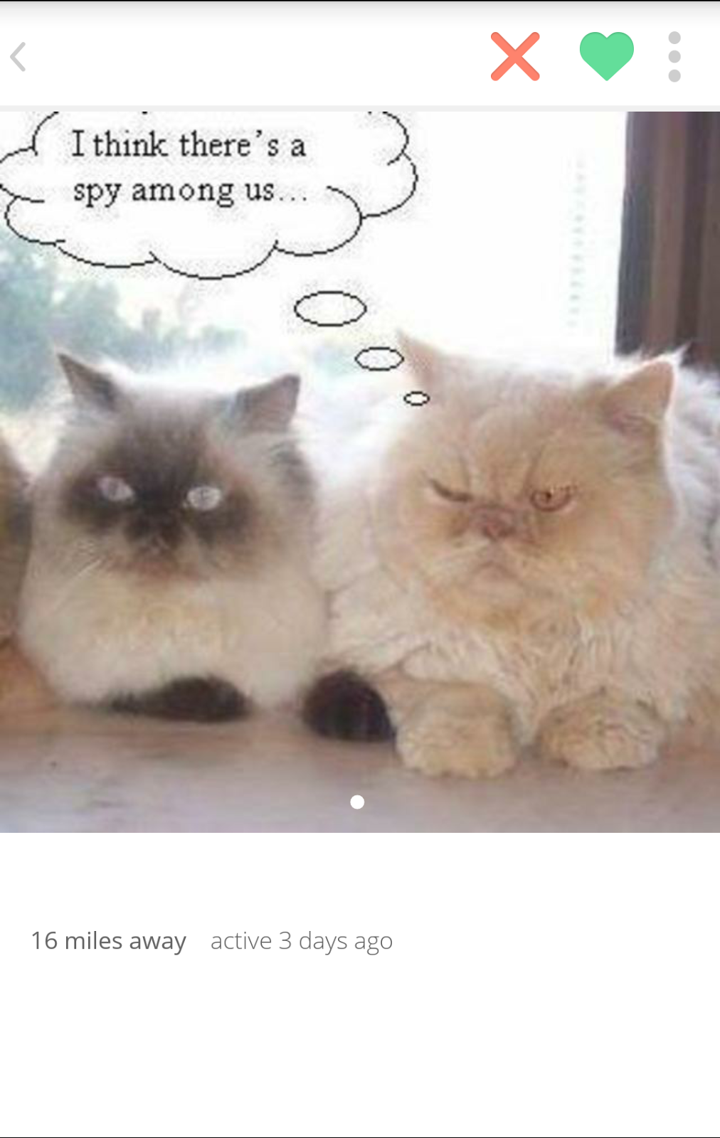
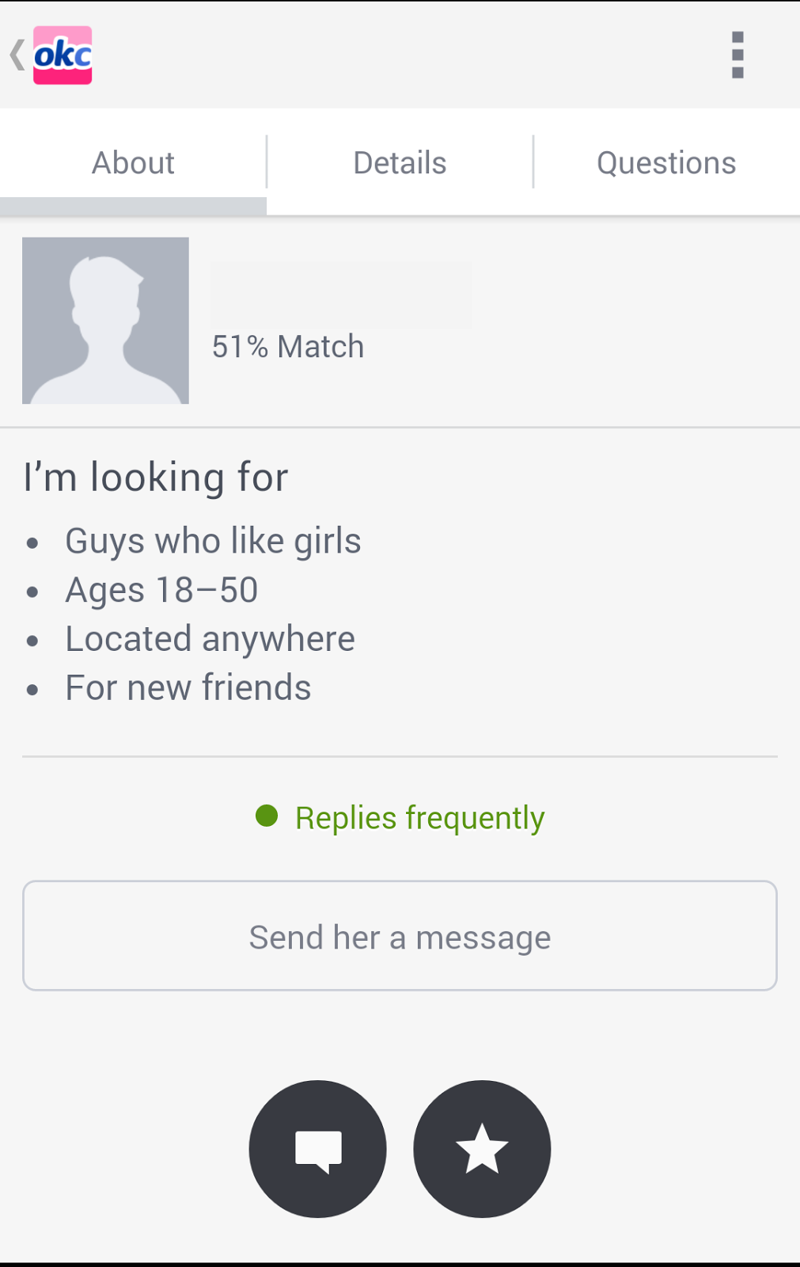
Profile Pages Pictures

Slide 5
User Profile Searching
Users can be searched using various different filters related to physical attributes.
Zoosk, Tinder, Match.com
Pros:
Able to use filters related to physical attributes
Limit searches to more desirable profiles based on the users preferences
Cons:
The search is limited to physical appearance, factors like sense of humor cannot be searched
It takes a lot of time for inputting all of the necessary preferences

Slide 6
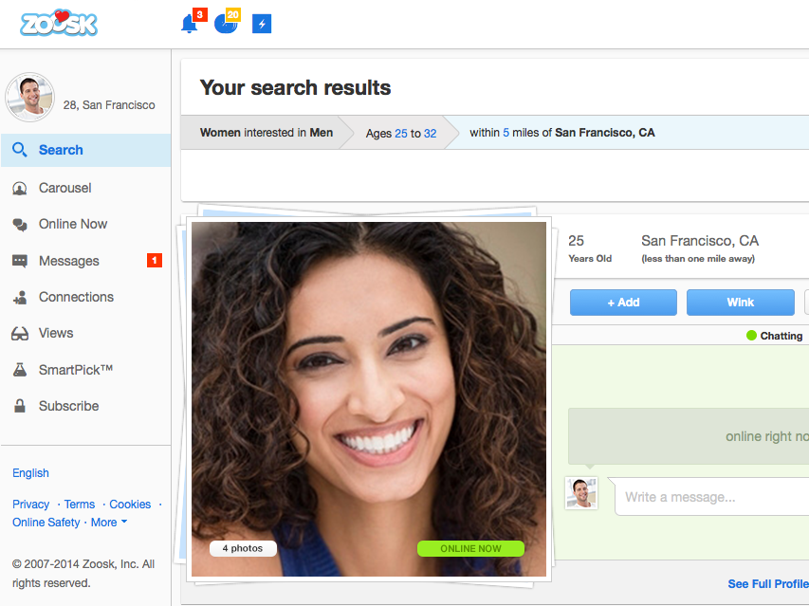
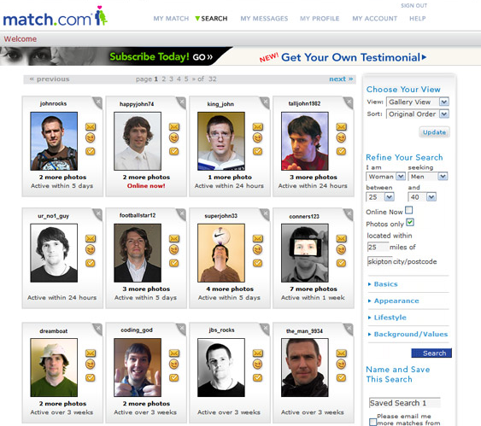
User Profile Searching Pictures

Slide 7
Instant Messaging
Able to contact users in a private message
okCupid, PlentyofFish, Tinder
Pros:
Allows users to have faster private contact between each other
Users can get a feel for who the person really is beyond their profile description
Cons:
Since there is no face to face contact, users cannot fully grasp facial expressions, body language, or sarcasm
Reasons for ceasing of messages can be difficult to interpret
Can be difficult to converse with a user that receives a lot of messages

Slide 8
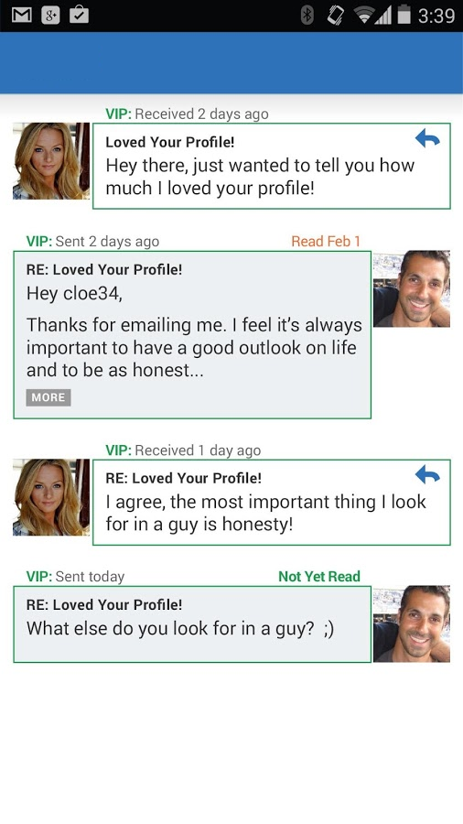
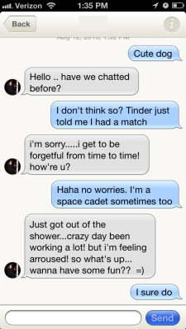
Private Messaging Pictures

Slide 9
“Viewed Me”
Ability to see users that have viewed your profile
okCupid, Lavalife
Pros:
Able to see users that have visited your profile and have remained silent, showing potential stalkers
Gauge the attractiveness of your profile based on how many other users are visiting
Cons:
No anonymous browsing since the other users know when someone is visiting their profile
Misclick on profile or simply browsing a profile can show false interest

Slide 10
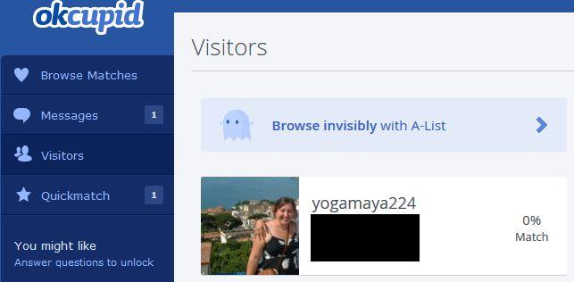
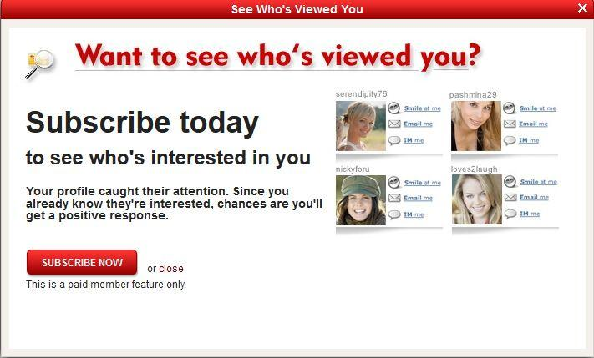
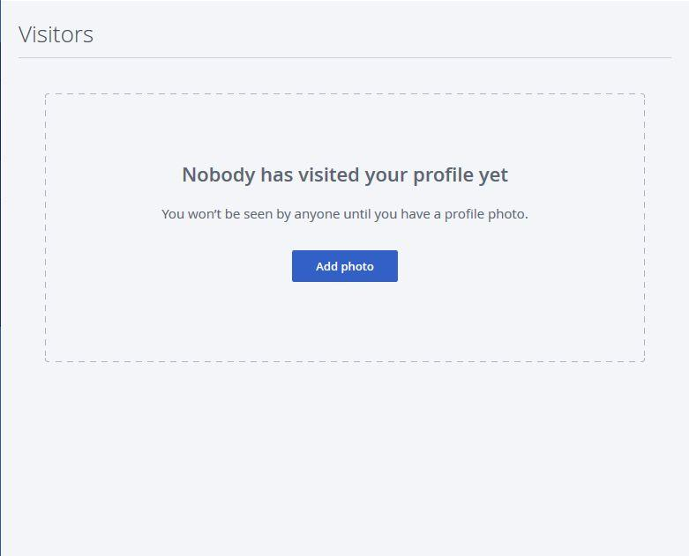
“Viewed Me” Pictures

Slide 11
Computer Algorithm Matching
Automatically matching users based on their information
okCupid, Match.com
Pros:
Can be used to find a quick date
Shows instant matches based on set preferences for physical attributes, removing the hassle of inputting them every time
Cons:
Takes a lot of time and effort in order to answer the questionnaires
It does not account for Out-of-Date Users
Algorithm can be incorrect, it can match users that are not good matches
Users can doubt the accuracy of the algorithm; a match will only be good if the users believe it is
The algorithm limits the users it shows, potentially hiding the right match

Slide 12
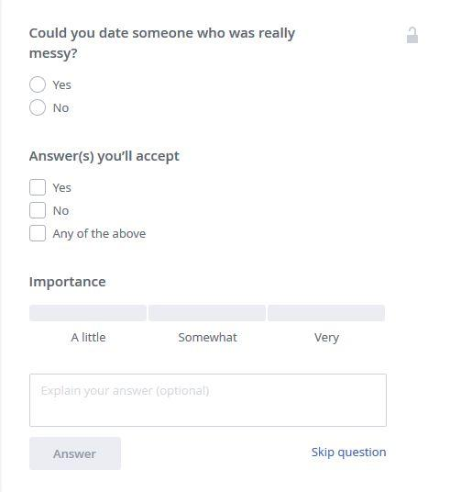
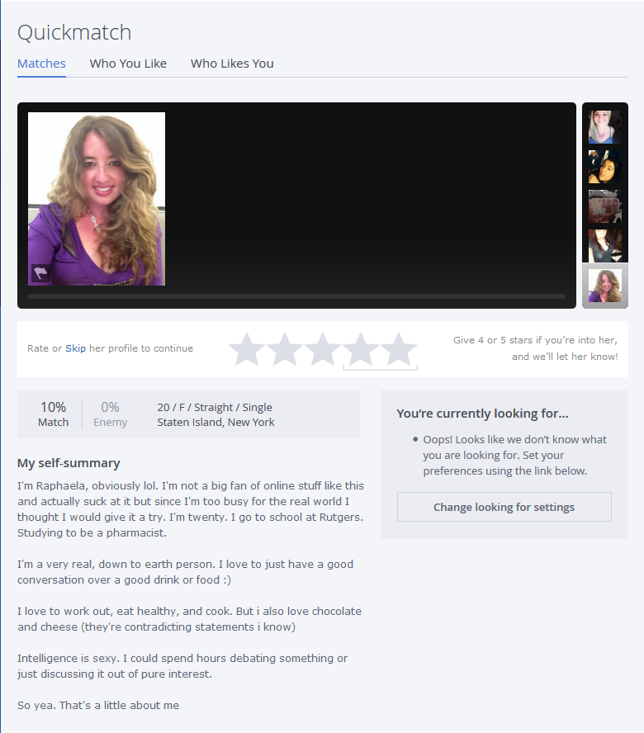
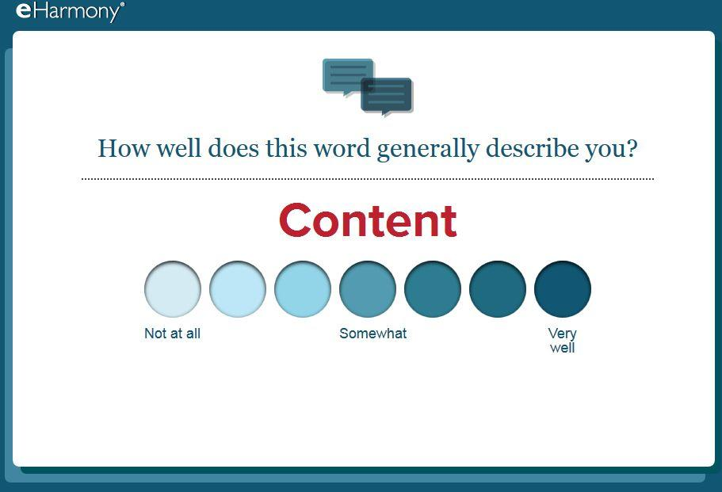

Computer Algorithm Matching Pictures

Slide 13
Social Media Connectivity
Ability or requirement to link a social media account
Zoosk, AnastasiaDate, Tinder
Pros:
Easy profile creation and importing of information
The applications use mutual connections increasing the chance of a relationship, since someone is more likely to go out with a friend of a friend
Cons:
Excludes people who do not have a social media account
Users don’t trust giving out their personal social media account information

Slide 14
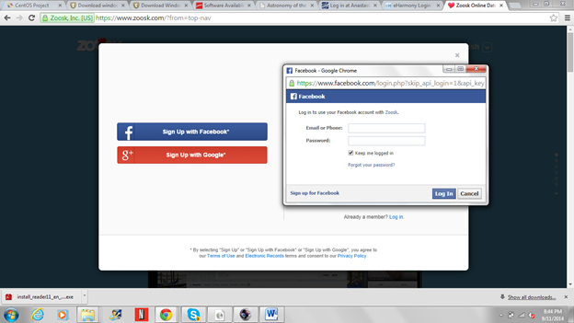
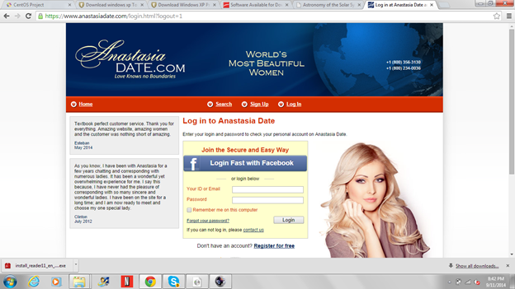
Social Media Connectivity Pictures

Slide 15
Mobile Support
Having a mobile application or a mobile website, available to use the service
Tinder, okCupid, Plenty of Fish
Pros:
Service can be used from many more locations since users have their phone everywhere
Since it is more easily accessible, users can use it at their convenience
Cons:
Can exclude users that do not have a smartphone

Slide 16
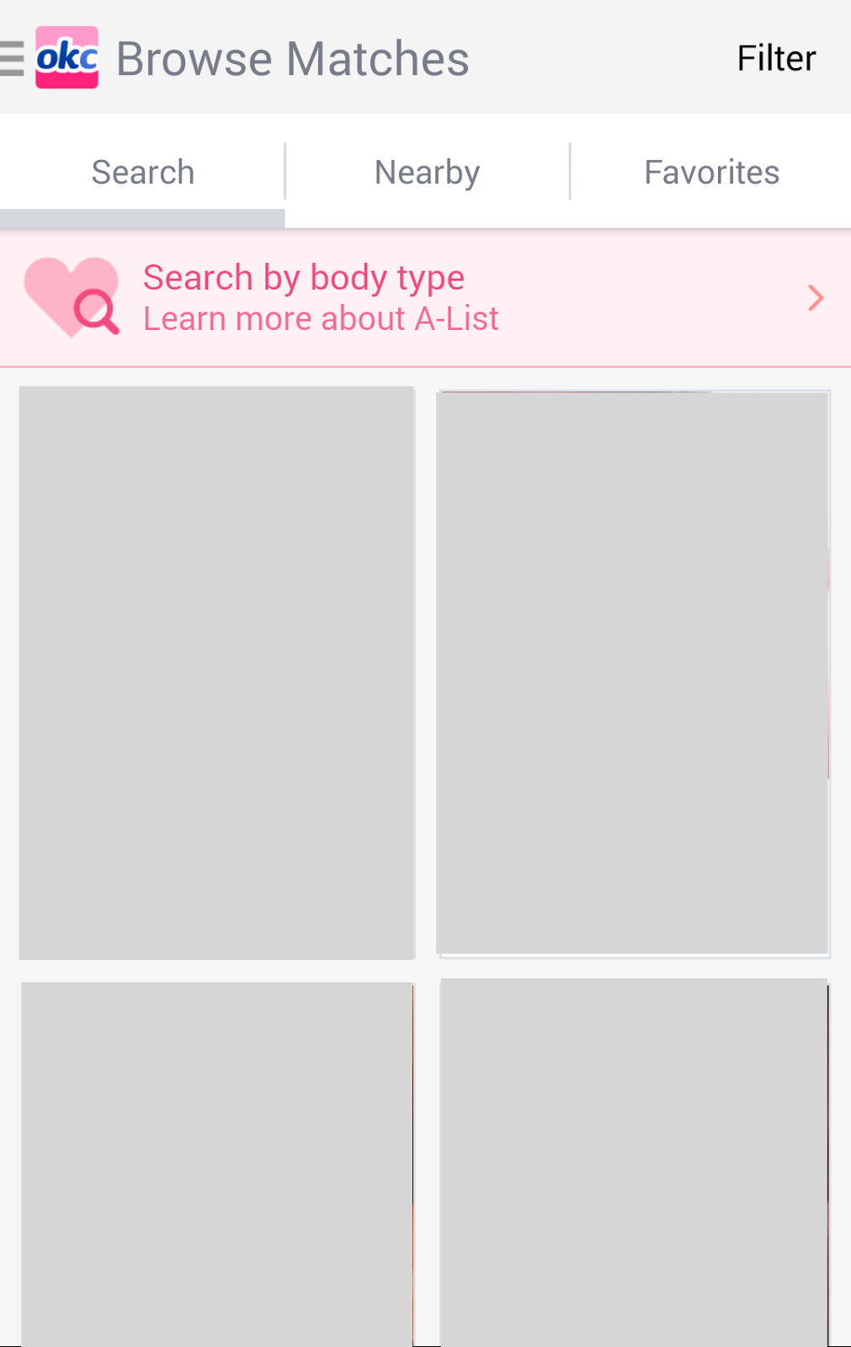
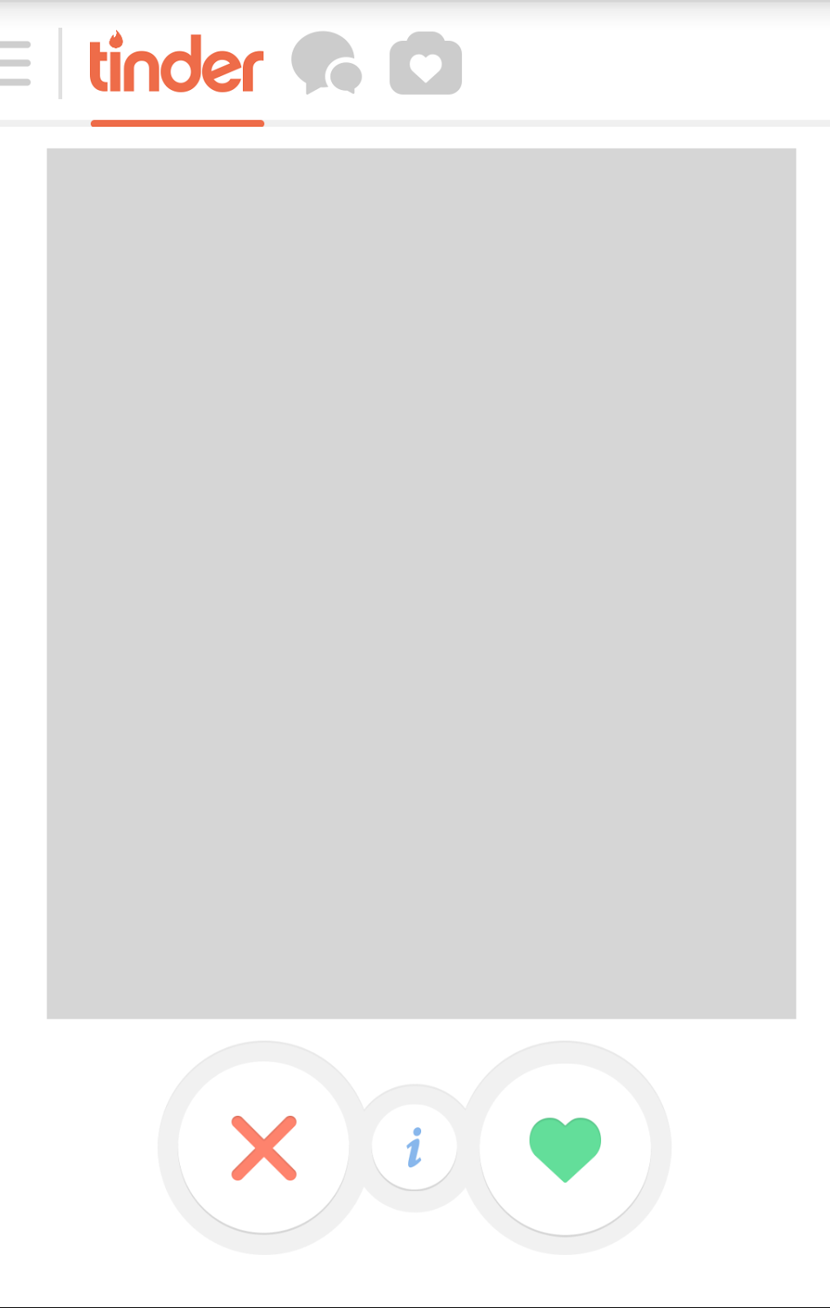
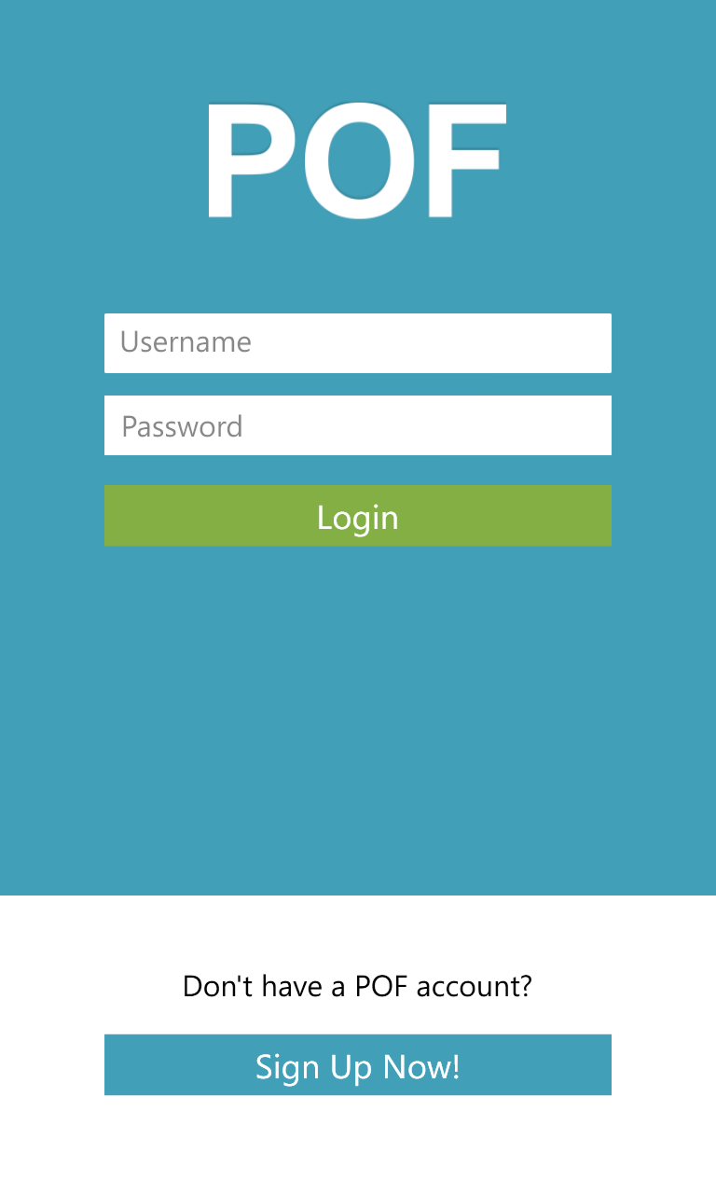
Mobile Compatibility Pictures

Slide 17
Like / Star
“Liking” or “Favoriting” a specific user
okCupid, Tinder, PlentyofFish
Pros:
Can be used to generate a list of users to be viewed later
Can let a user know that another user liked something about their profile
Cons:
It’s not a mode of communication
It doesn’t provide any real interaction between users
Does not show any serious interest towards users

Slide 18
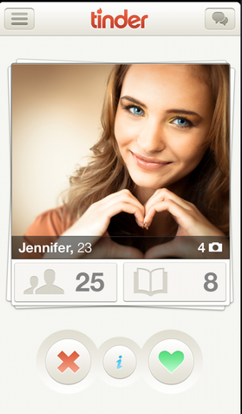
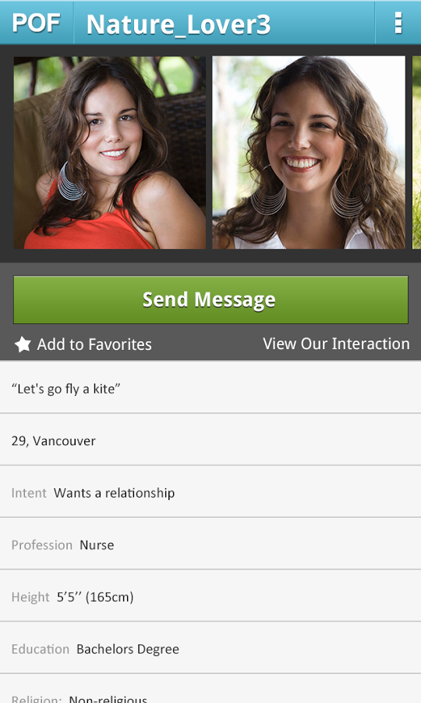
Like / Star Pictures

Slide 19
Real Time Notification
Provides an instant notification if someone messages or has some form of interaction
Tinder, okCupid, Zoosk
Pros:
Users won’t miss out on the messages and can reply faster
Avoids the hassle of constantly looking at the application to see if someone has messaged or has some form of interaction
Cons:
The application can send constant notifications to try to get the user to user to use the application more often

Slide 20
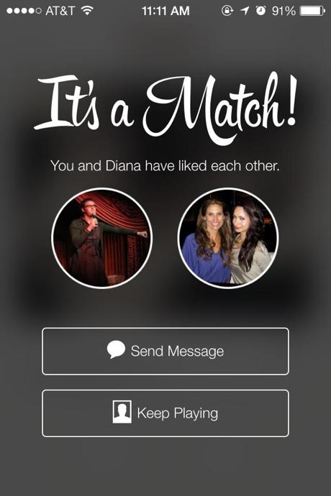
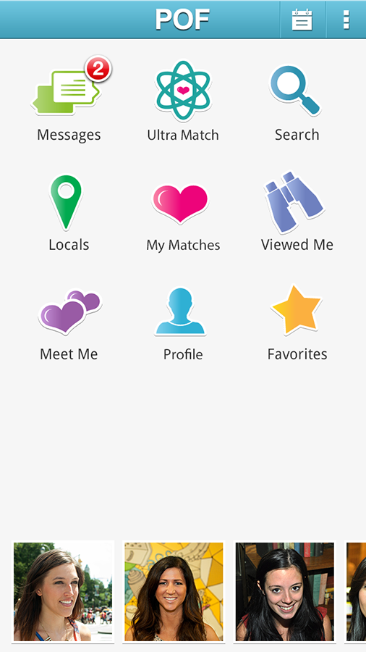
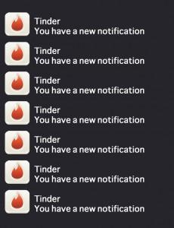
Real Time Notification Pictures

Slide 21
The Filtered Encounter: Online Dating and the Problem of Filtering Through Excessive Information
The large network of people on dating sites had led to information overload due to too many profiles, too much information, and too many potential romantic partners
Filtering through the many options, partners, and choices has become a prime concern of users
More focused on filtering out unsuitable partners than on catching potential mates
“Shopping culture” of dating has been created; users are simply browsed through like merchandise
Self-presentation tactics and strategies of searching profile commentary and photographs become the most important
Notes:
The problem that this paper presents is that there are so many available options and choices of people on dating websites due to the size of the network that information overload now afflicts users.
This has made the ability to filter through the profiles of users much more of a concern to the users.
The amount of filtering that people now do moves the focus of these dating websites to filtering out all the people that are undesirable rather than searching for the ones that are desirable.
“Shopping culture” exists through this. Users are browsed through on the site like items on Amazon.
Because self-presentation tactics and strategies of searching profiles now become the most important factor in finding someone on a dating site, users that have been using the site longer and have gained more experience in how to use it best gain an advantage over new users.

Slide 22
The Truth about Lying in Online Dating
People lie about their physical attributes, specifically height, weight and age, on their profile
The paper talks about three specific criteria:
Frequency of deception in online dating
Magnitude of lies
Gender differences in production of differences
Men look for youth and physical attractiveness in their partners, whereas women look for education and career
Women lie more about their age and weight
Men often lie about their height which is often associated with power and status.
Two-thirds of the participants’ weight was inaccurate by 5 pounds or more.

Slide 23
Who Visits Online Dating Sites? Exploring some Characteristics of Online Daters
Online dating sites allows the user to control their self presentation
Online dating was irrelevant to income and education level
People between the age of 30 - 50 were the most active users
It is much easier to stop talking to someone without feeling guilty
Online dating has evolved to mainstream social practice
This paper talks about two opposing hypotheses:
Social compensation hypothesis, which explains that people with higher dating anxiety benefit more from online dating because there is no face to face conversation involved
The rich-get-richer hypothesis explains that people with low dating anxiety benefit from online dating because they see it as just another way of finding a partner

Slide 24
An Experiment Investigating the Links Among Online Dating Profile Attractiveness, Ideal Endorsement, and Romantic Media
Exposure to romantic media are related to profile attractiveness, romantic beliefs, and endorsement of ideal partner characteristics. (people will based their ideal person based on their perception of someone from the media)
Consuming romantic media predicted stronger endorsement of romantic beliefs and higher ratings of profile attractiveness.
People who watch romantic movies and consume other romantic media have been exposed to romantic ideology and philosophy
Notes:
exposure to romantic media are related to profile attractiveness, romantic beliefs, and endorsement of ideal partner characteristics.

